Slide 1
s
Finding best delivery points for pizza chain
By Pavan Kumar Vangala

Slide 2
1. Problem Statement
A pizza chain wants to open its delivery centers across a city. What do you think would be the possible challenges?
Understand as to how many pizza stores has to be opened to cover delivery in the area.
Figure out the locations for the pizza stores within all these areas in order to keep the distance between the store and delivery points minimum.
Analyze the areas having more pizza orders.

Slide 3
2. Dataset

Slide 4
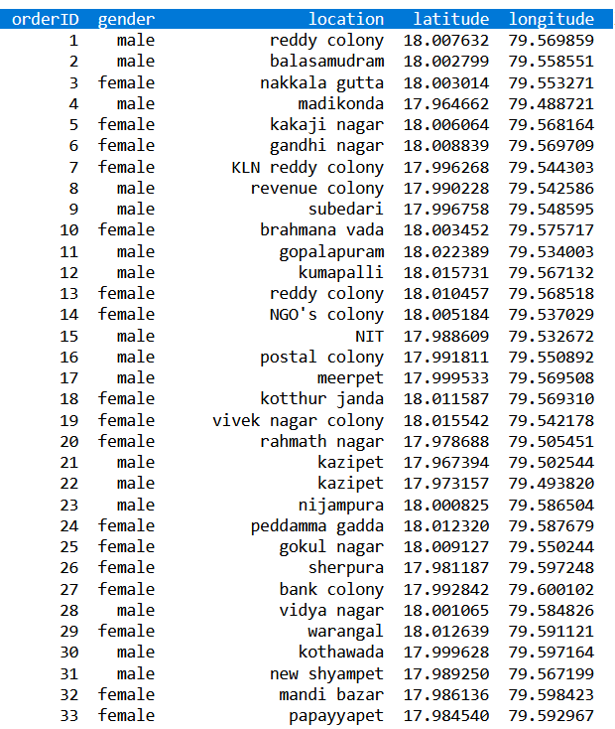
Overview of Dataset
The dataset name is Data.csv
This size of dataset is (100,4) that means 150 rows and 4 columns.
Columns are :
1.orderID
2.gender
3.location
4.latitude
5.longitude

Slide 5
3. Project Architecture
Data: The size of the dataset is (100, 4) which is 100 rows and 4 columns. Also on dataset does not contain any NULL or NaN values.
Algorithms: K-means algorithm is used in this project to analyze and form clusters of locations based on their latitudes and longitudes.
Model: K-means model is used and is hyper tuned parameters like n_clusters=3 using elbow method to ﬁnd the optimal number of clusters.
Programming Language: Python 3.6
Environment (Libraries and Technologies): Numpy, Folium, Pandas, Matplotlib, Jupyter, Google Colab.

Slide 6






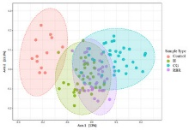



4. Work Flow
Dataset BY-NC
Data pre-processing BY-NC
Data Analysis
WCSS
Visualization BY-NC
K-means clustering
Optimal number of Clusters BY-NC

Slide 7

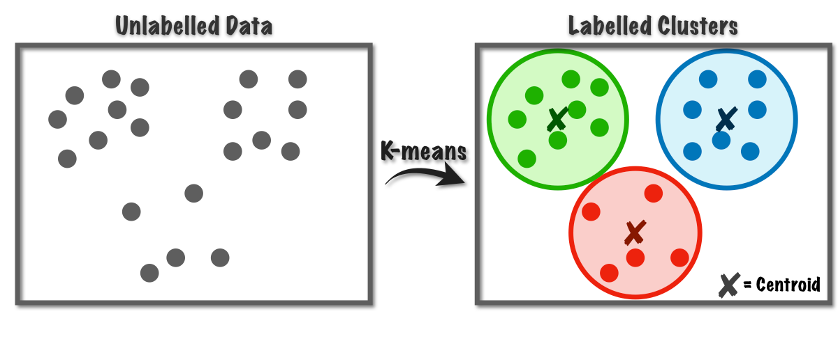
K-Means Clustering
K-means clustering is one of the simplest and popular unsupervised machine learning algorithms.
The K in K-means represents the user-defined k-number of clusters.
K-means clustering works by attempting to find the best cluster centroid positions within the data for k-number of clusters, ensuring data within the cluster is closer in distance to the given centroid than it is to any other centroid.
Ideally, the resulting clusters maximize similarity amongst the data within each unique cluster.

Slide 8
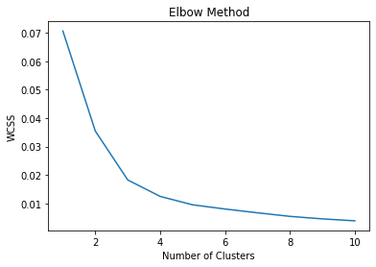

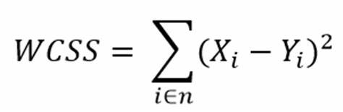
Elbow Method
K refers to the number of optimal clusters.
Using Elbow method we can find the value of K.
WCSS means within cluster sum of squares of distances of data points from their cluster centroids.
From fig. k =3

Slide 9
5. Implementation and Analysis

Slide 10
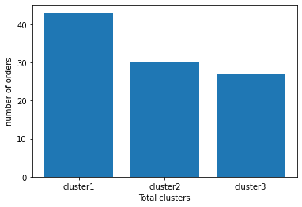
5.1 Clusters vs no of Orders
From figure we can say that cluster-1 has more number of orders.
Cluster1 : 43 orders
Cluster2 : 30 orders
Cluster3 : 27 orders

Slide 11
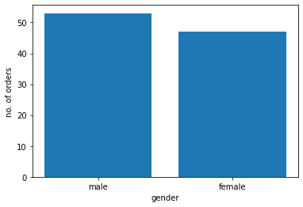
5.2 Gender vs no. of Orders
From figure we can say that more number of males are ordering pizza than females.
Male : 52 orders
Female : 48 orders

Slide 12

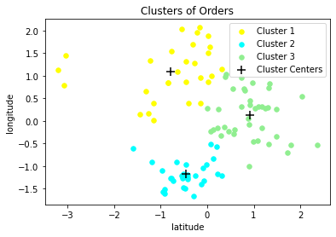
5.3 Clusters Visualization

Slide 13
6. Conclusion

Slide 14
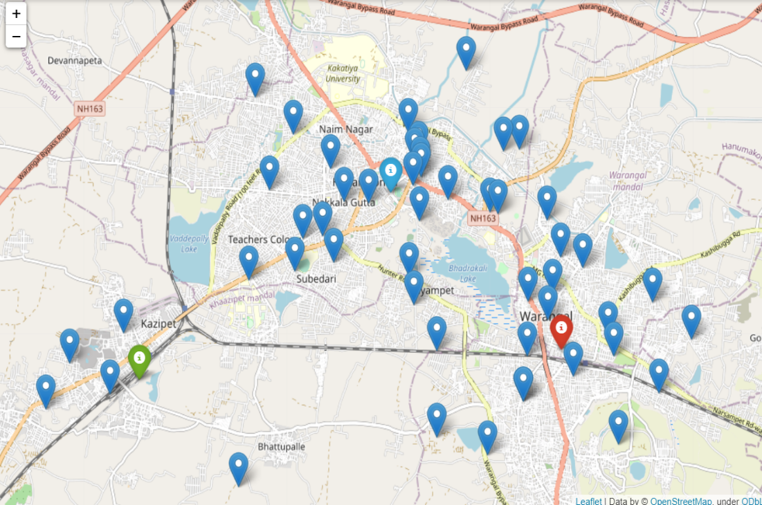
There are three cluster centers (green, blue, red) in the figure which indicates data is divided into three groups. Hence the number of pizza delivery centers to be opened are 3.
Locations :
Kazipet,Khazipet mandal, Hanamkonda,Telangana,506003,India.
Laxmipuram, Nakkala Gutta, Hanamakonda mandal, Hanamakonda, Telangana, 506001, India.
Khila Warangal mandal, hanamakonda, Telangana, 506002, India.

Slide 15

Thankyou!

